Slide 1


Trento, 02 December 2020
Ph.D. Student: Chiara Nardin
chiara.nardin@unitn.it
Probabilistic
Seismic Hazard & Fragility Analysis
Hands-on: Matlab Tutorials
Ph.D. Student Chiara Nardin – M.Sc., Eng. in Civil Engineering
https://github.com/kia13nn/ISPS.git

Slide 2
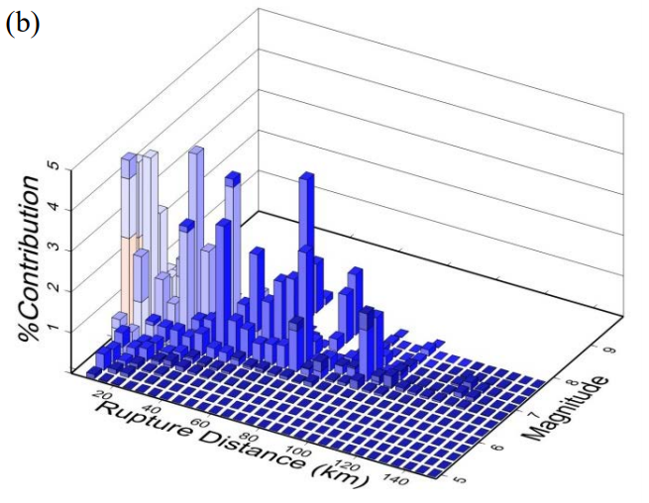
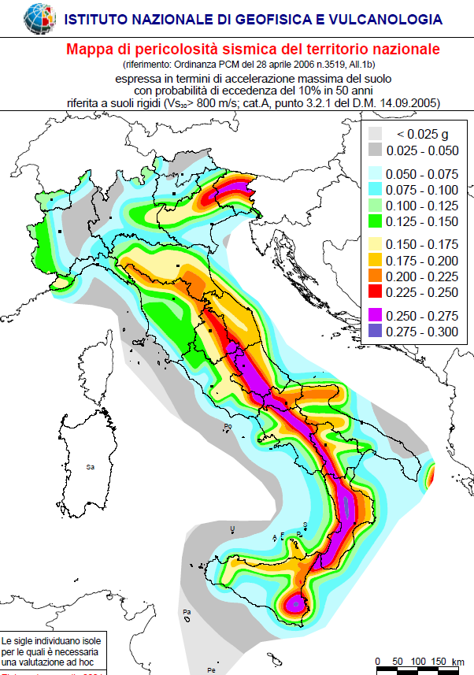
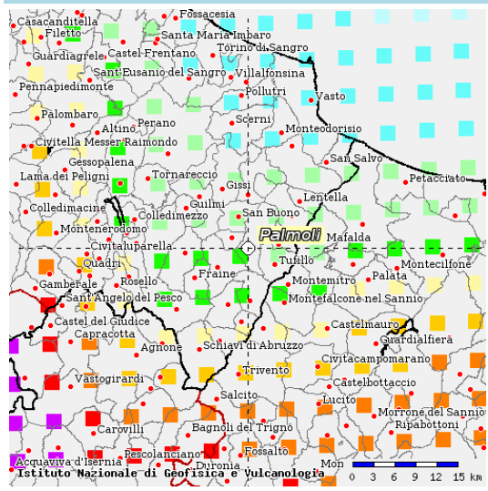
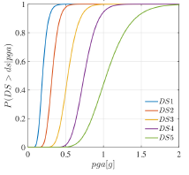
Trento, 02 December 2020
Ph.D. Student: Chiara Nardin
chiara.nardin@unitn.it
Introduction | Probabilistic Hazard Analysis | Fragility Analysis | References
Course outline:
Introduction
PBEE overview
the PEER-PBEE framework
Probabilistic Seismic Hazard Model
Concept and Formulation
Hazard Computation (MatLab)
Vulnerability and Fragility Analysis
Concept and Formulation
Fragility Computation (MatLab)
References
http://zonesismiche.mi.ingv.it/

Slide 3
Trento, 02 December 2020
Ph.D. Student: Chiara Nardin
chiara.nardin@unitn.it
Introduction
Performance Based Earthquake Engineering
Ph.D. Student Chiara Nardin – M.Sc., Eng. in Civil Engineering
https://github.com/kia13nn/ISPS.git

Slide 4
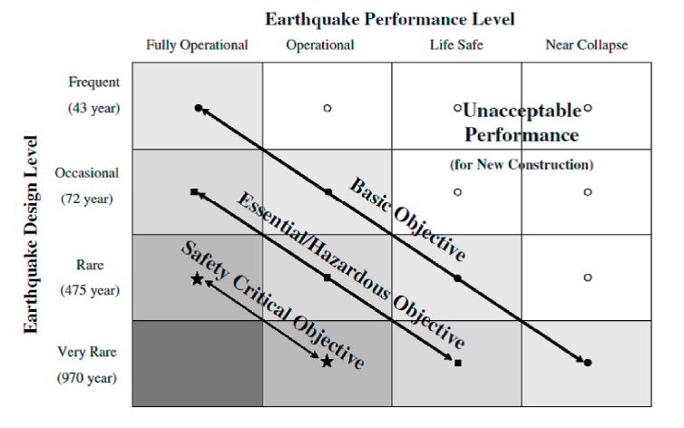
Trento, 02 December 2020
Ph.D. Student: Chiara Nardin
chiara.nardin@unitn.it
Introduction | Probabilistic Hazard Analysis | Fragility Analysis | References
PBEE: Performance Based Earthquake Engineering
Probabilistic framework for (i) assessing design, (ii) evaluation and (iii) planning of civil system.
load-and-resistence-factor design (LRFD)
performance based design (PBD):
3Ds – i.e. downtime, dollars, death
2 axes define the domain of acceptable system’s response:
System performance objectives
Seismic hazard level, w.r.t. return periods
Fig.1 – PBEE concept: seismic performance objectives vs seismic hazard level. ©Poland et al.,(1995)-Vision 2000: Performance Based Earthquake Engineering of buildings. Structural Engineers Association of California, Sacramento, CA.

Slide 5
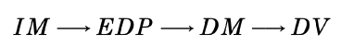
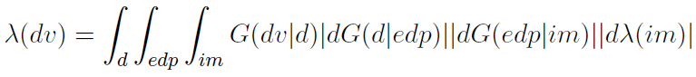

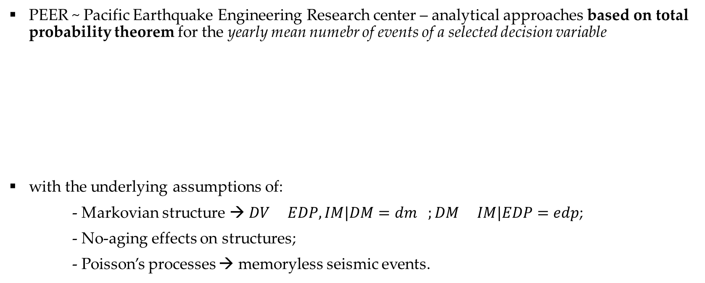
Trento, 02 December 2020
Ph.D. Student: Chiara Nardin
chiara.nardin@unitn.it
Introduction | Probabilistic Hazard Analysis | Fragility Analysis | References
The PEER-PBEE Framework
PEER ~ Pacific Earthquake Engineering Research center – analytical approaches based on total probability theorem for the yearly mean numebr of events of a selected decision variable
with the underlying assumptions of:
- Markovian structure → $DV EDP,IM|DM=dm ;DM IM|EDP=edp$;
- No-aging effects on structures;
- Poisson’s processes → memoryless seismic events.

Slide 6
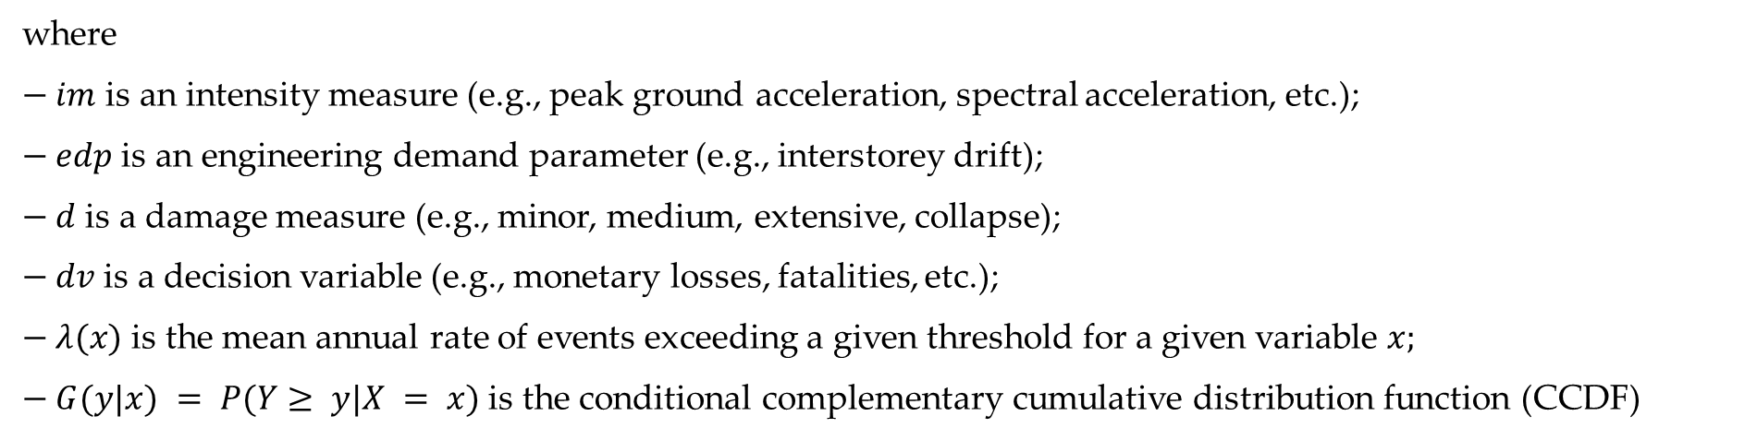
Trento, 02 December 2020
Ph.D. Student: Chiara Nardin
chiara.nardin@unitn.it
Introduction | Probabilistic Hazard Analysis | Fragility Analysis | References
The PEER-PBEE Framework
where
$− im$ is an intensity measure (e.g., peak ground acceleration, spectral acceleration, etc.);
$− edp$ is an engineering demand parameter (e.g., interstorey drift);
$− d$ is a damage measure (e.g., minor, medium, extensive, collapse);
$− dv$ is a decision variable (e.g., monetary losses, fatalities, etc.);
$− λ(x)$ is the mean annual rate of events exceeding a given threshold for a given variable $x;$
$− G(y|x) = P(Y≥ y|X = x)$ is the conditional complementary cumulative distribution function (CCDF)

Slide 7



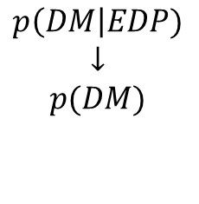
Trento, 02 December 2020
Ph.D. Student: Chiara Nardin
chiara.nardin@unitn.it
Introduction | Probabilistic Hazard Analysis | Fragility Analysis | References
The PEER-PBEE Framework
Hazard analysis
intensity measure
Loss analysis
decision variable
HAZARD
VULNERABILITY
Damage analysis
damage measure
DECISION MAKING
VULNERABILITY
Vulnerability analysis
engineering demand par.
(i) hazard analysis
(ii) fragility analysis
(iii) damage analysis
(iv) loss analysis
$$p\left(IM\right|M,R)$$
$$↓$$
$$p(IM)$$
$$p\left(EDP\right|IM)$$
$$↓$$
$$p(EDP)$$
$$p\left(DM\right|EDP)$$
$$↓$$
$$p(DM)$$
$$p\left(DV\right|DM)$$
$$↓$$
$$p(DV)$$

Slide 8
Trento, 02 December 2020
Ph.D. Student: Chiara Nardin
chiara.nardin@unitn.it
Probabilistic Hazard Analysis
Formulation and MatLab Computation
Ph.D. Student Chiara Nardin – M.Sc., Eng. in Civil Engineering

Slide 9
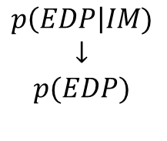


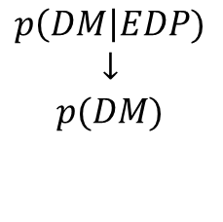
Trento, 02 December 2020
Ph.D. Student: Chiara Nardin
chiara.nardin@unitn.it
Introduction | Probabilistic Hazard Analysis | Fragility Analysis | References
Seismic Hazard Analysis
Hazard analysis
intensity measure
Loss analysis
decision variable
HAZARD
VULNERABILITY
Damage analysis
damage measure
DECISION MAKING
VULNERABILITY
Vulnerability analysis
engineering demand par.
SHA is the basis for many earthquake design codes and for seismic risk analysis of civil systems.
Useful definitions:
seismic hazard := the exceedance (or occurrence) probability for a given ground motion intensity measure threshold, site and time interval
seismic risk:= the exceedance (or occurrence) probability for a given loss threshold, site and time interval.
$$p\left(IM\right|M,R)$$
$$↓$$
$$p(IM)$$
$$p\left(EDP\right|IM)$$
$$↓$$
$$p(EDP)$$
$$p\left(DM\right|EDP)$$
$$↓$$
$$p(DM)$$
$$p\left(DV\right|DM)$$
$$↓$$
$$p(DV)$$
Notes:
SHA is the basis for many earthquake design codes practices and for seismic risk analysis of civil systems.

Slide 10
Trento, 02 December 2020
Ph.D. Student: Chiara Nardin
chiara.nardin@unitn.it
Introduction | Probabilistic Hazard Analysis | Fragility Analysis | References
DSHA
Evaluate the worst-case scenario
PSHA
Evaluate the exceedance probability of a given g.m. IM threshold at given site and time interval
Seismic Hazard Analysis – DSHA vs PSHA
Four steps of a DSHA and PSHA analyses - Kramer, 1996
Notes:
SHA is the basis for many earthquake design codes practices and for seismic risk analysis of civil systems.

Slide 11
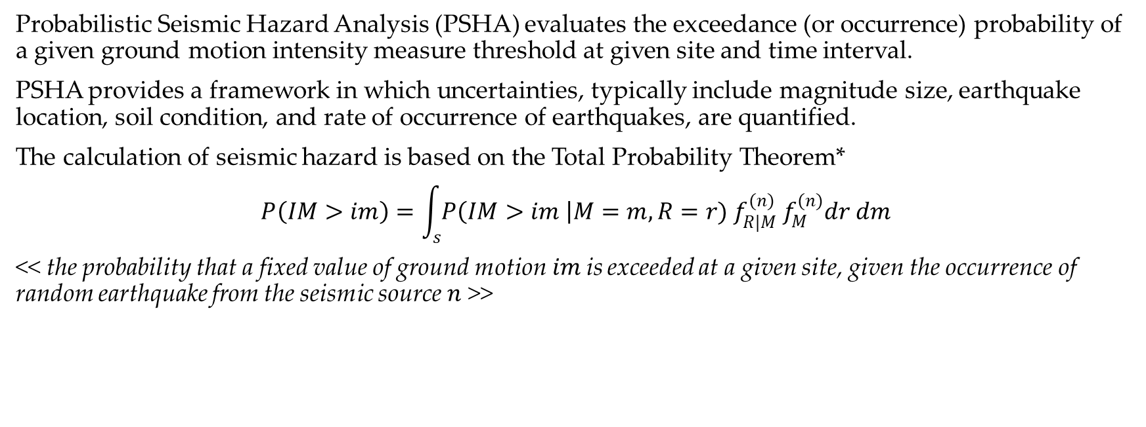
Trento, 02 December 2020
Ph.D. Student: Chiara Nardin
chiara.nardin@unitn.it
Introduction | Probabilistic Hazard Analysis | Fragility Analysis | References
PSHA
Probabilistic Seismic Hazard Analysis (PSHA) evaluates the exceedance (or occurrence) probability of a given ground motion intensity measure threshold at given site and time interval.
PSHA provides a framework in which uncertainties, typically include magnitude size, earthquake location, soil condition, and rate of occurrence of earthquakes, are quantified.
The calculation of seismic hazard is based on the Total Probability Theorem*
$$P\left(IM>im\right)=\int_{s}{P\left(IM>im \right|M=m, R=r){ f}_{R|M}^{(n)} f_{M}^{(n)}dr dm}$$
<< the probability that a fixed value of ground motion$im$is exceeded at a given site, given the occurrence of random earthquake from the seismic source $n$ >>
(1)
*see Notes at the end of Presentation

Slide 12
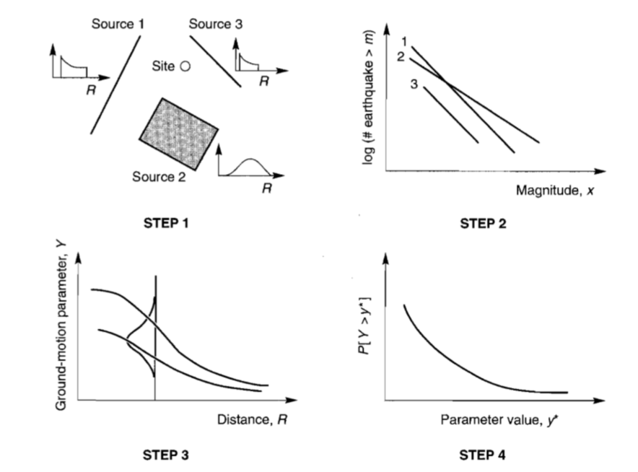
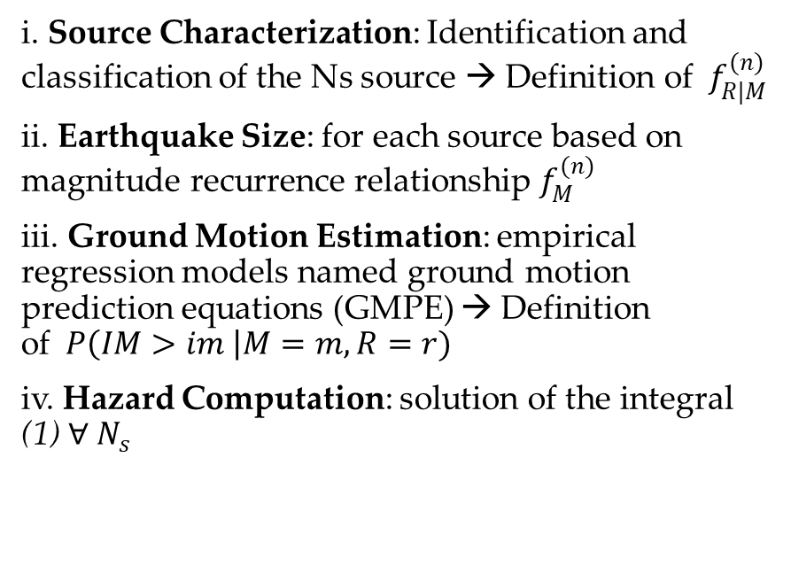
Trento, 02 December 2020
Ph.D. Student: Chiara Nardin
chiara.nardin@unitn.it
Introduction | Probabilistic Hazard Analysis | Fragility Analysis | References
PSHA - Steps
i. Source Characterization: Identification and classification of the Ns source → Definition of ${ f}_{R|M}^{(n)}$
ii. Earthquake Size: for each source based on magnitude recurrence relationship $f_{M}^{(n)}$
iii. Ground Motion Estimation: empirical regression models named ground motion prediction equations (GMPE) → Definition of$P\left(IM>im \right|M=m, R=r)$
iv. Hazard Computation: solution of the integral (1) $∀ N_{s}$

Slide 13
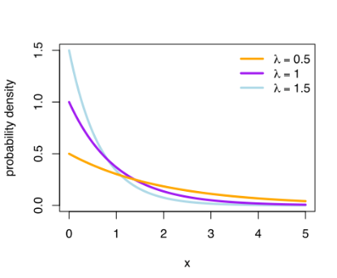
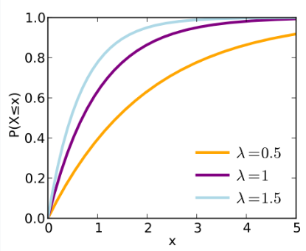
Trento, 02 December 2020
Ph.D. Student: Chiara Nardin
chiara.nardin@unitn.it
Introduction | Probabilistic Hazard Analysis | Fragility Analysis | References
PSHA – Assumptions:
Eq. (1) is based on the following assumptions:
Earthquakes form a stochastic process;
Earthquakes can be considered instantaneous events and memory-less
the occurrence of earthquakes can be defined as Homogeneus Poisson Process (HPP)
PDF
CDF
exponential distribution of earthquake recurrence

Slide 14
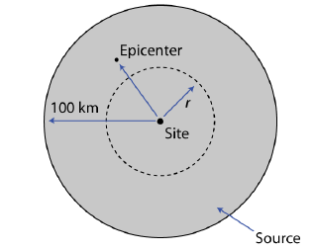
Trento, 02 December 2020
Ph.D. Student: Chiara Nardin
chiara.nardin@unitn.it
Introduction | Probabilistic Hazard Analysis | Fragility Analysis | References
PSHA – Step 1: Earthquake source characterization
Goal: to identify
Fault sources: individual or multiple identified faults
Area sources: defined by polygons in which seismicity is assumed uniform
(Identification based upon the interpretation of geological, geophysical and seismological – historical data)
and to characterize seismic sources
Point source
Linear source
Area source
(the geometry of the source is used to identify the probability distribution of source-to-site distances)
SOURCES
DISTANCES

Slide 15
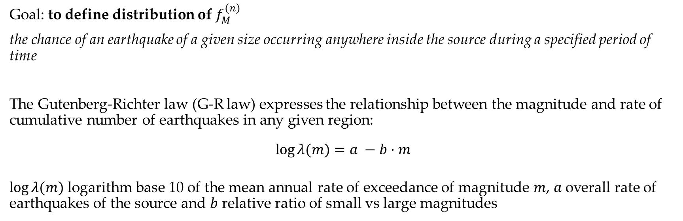
Trento, 02 December 2020
Ph.D. Student: Chiara Nardin
chiara.nardin@unitn.it
Introduction | Probabilistic Hazard Analysis | Fragility Analysis | References
PSHA – Step 2: Earthquake size (Recurrence law)
Goal: to define distribution of $f_{M}^{(n)}$
the chance of an earthquake of a given size occurring anywhere inside the source during a specified period of time
The Gutenberg-Richter law (G-R law) expresses the relationship between the magnitude and rate of cumulative number of earthquakes in any given region:
$$\log{λ(m)}=a −b⋅m$$
$\log{λ(m)}$logarithm base 10 of the mean annual rate of exceedance of magnitude $m$, $a$overall rate of earthquakes of the source and $b$ relative ratio of small vs large magnitudes

Slide 16
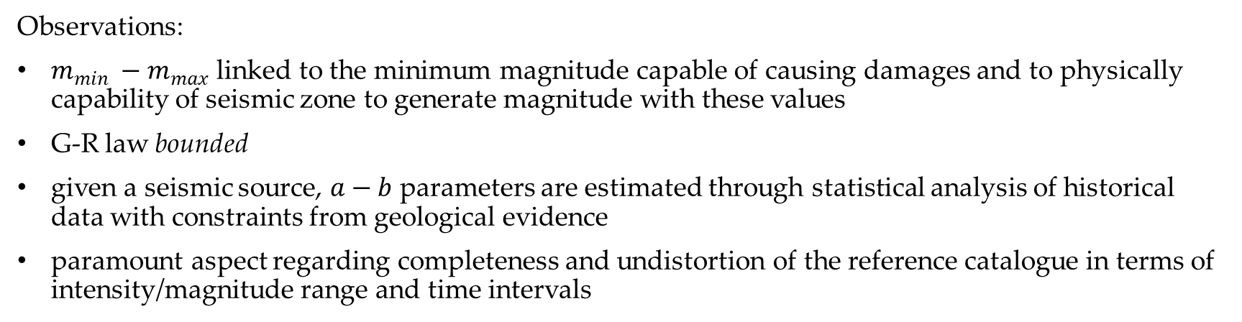
Trento, 02 December 2020
Ph.D. Student: Chiara Nardin
chiara.nardin@unitn.it
Introduction | Probabilistic Hazard Analysis | Fragility Analysis | References
PSHA – Step 2: Earthquake size (Recurrence law)
Observations:
$m_{min} −m_{max}$ linked to the minimum magnitude capable of causing damages and to physically capability of seismic zone to generate magnitude with these values
G-R law bounded
given a seismic source, $a−b$ parameters are estimated through statistical analysis of historical data with constraints from geological evidence
paramount aspect regarding completeness and undistortion of the reference catalogue in terms of intensity/magnitude range and time intervals

Slide 17
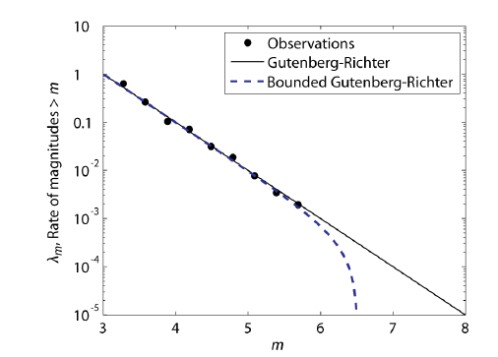
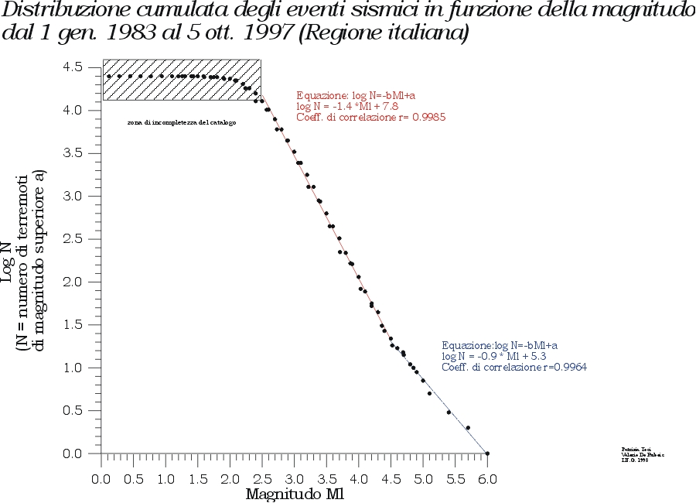
Trento, 02 December 2020
Ph.D. Student: Chiara Nardin
chiara.nardin@unitn.it
Introduction | Probabilistic Hazard Analysis | Fragility Analysis | References
PSHA – Step 2: Earthquake size (Recurrence law)
Observations:
http://legacy.ingv.it/roma/attivita/pererischio/macrosismica/Seismic/seismic.html

Slide 18
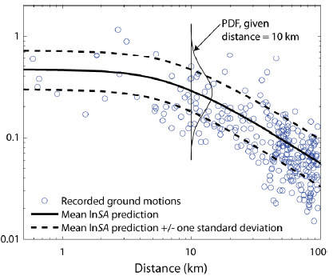
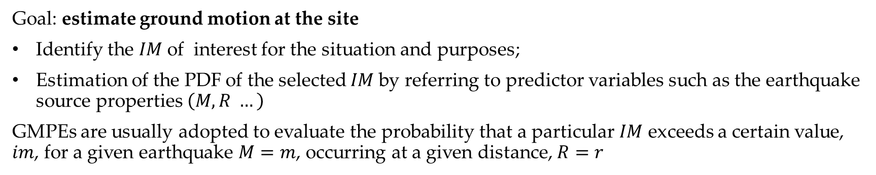
Trento, 02 December 2020
Ph.D. Student: Chiara Nardin
chiara.nardin@unitn.it
Introduction | Probabilistic Hazard Analysis | Fragility Analysis | References
PSHA – Step 3: Ground motion predictive equations (GMPE)
Goal: estimate ground motion at the site
Identify the $IM$of interest for the situation and purposes;
Estimation of the PDF of the selected $IM$by referring to predictor variables such as the earthquake source properties $\left(M,R …\right)$
GMPEs are usually adopted to evaluate the probability that a particular $IM$ exceeds a certain value, $im$, for a given earthquake $M=m$, occurring at a given distance, $R=r$
Schematic illustration of conditional probability of exceeding a particular value of a
ground motion parameter for a given magnitude and distance.

Slide 19
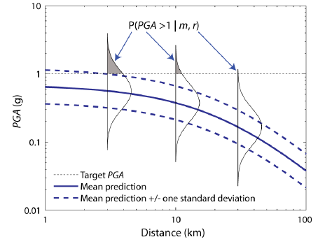
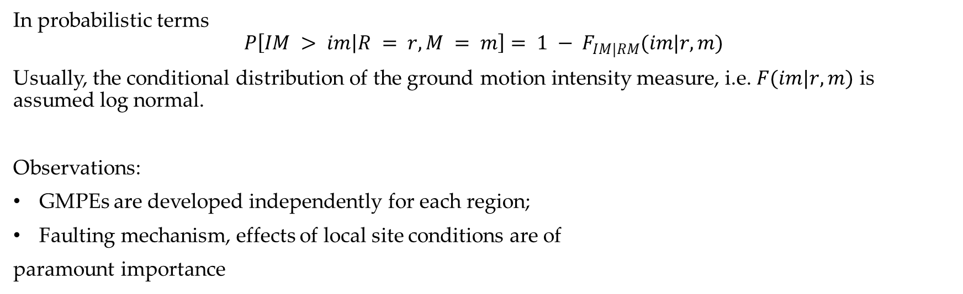
Trento, 02 December 2020
Ph.D. Student: Chiara Nardin
chiara.nardin@unitn.it
Introduction | Probabilistic Hazard Analysis | Fragility Analysis | References
PSHA – Step 3: Ground motion predictive equations (GMPE)
In probabilistic terms
$$P\left[IM > im | R = r,M = m\right]= 1 − F_{IM|RM}(im|r,m)$$
Usually, the conditional distribution of the ground motion intensity measure, i.e. $F(im|r,m)$ is assumed log normal.
Observations:
GMPEs are developed independently for each region;
Faulting mechanism, effects of local site conditions are of
paramount importance
Schematic illustration of conditional probability of exceeding a particular value of a
ground motion parameter for a given magnitude and distance.

Slide 20
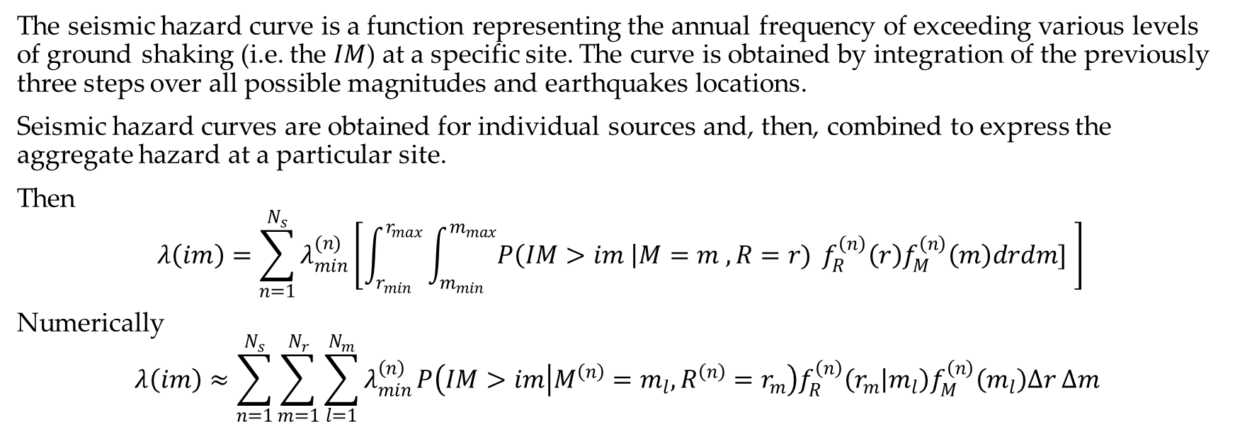
Trento, 02 December 2020
Ph.D. Student: Chiara Nardin
chiara.nardin@unitn.it
Introduction | Probabilistic Hazard Analysis | Fragility Analysis | References
PSHA – Step 4: Hazard Computation
The seismic hazard curve is a function representing the annual frequency of exceeding various levels of ground shaking (i.e. the $IM$) at a specific site. The curve is obtained by integration of the previously three steps over all possible magnitudes and earthquakes locations.
Seismic hazard curves are obtained for individual sources and, then, combined to express the aggregate hazard at a particular site.
Then
$$λ\left(im\right)=\sum_{n=1}^{N_{s}}{λ_{min}^{(n)}}\left[\int_{r_{min}}^{r_{max}}{\int_{m_{min}}^{m_{max}}{P\left(IM>im \right|M=m , R=r)}} f_{R}^{\left(n\right)}\left(r\right)f_{M}^{\left(n\right)}\left(m\right)drdm] \right]$$
Numerically
$$λ\left(im\right)≈\sum_{n=1}^{N_{s}}{\sum_{m=1}^{N_{r}}{\sum_{l=1}^{N_{m}}{λ_{min}^{\left(n\right)}}P\left(IM>im | M^{\left(n\right)}=m_{l}, R^{\left(n\right)}=r_{m}\right)f_{R}^{\left(n\right)}\left(r_{m} | m_{l}\right)f_{M}^{\left(n\right)}\left(m_{l}\right)Δr Δm} }$$
(2)
(3)

Slide 21

Trento, 02 December 2020
Ph.D. Student: Chiara Nardin
chiara.nardin@unitn.it
Probabilistic Hazard Analysis
Formulation and MatLab Computation
Ph.D. Student Chiara Nardin – M.Sc., Eng. in Civil Engineering
https://github.com/kia13nn/ISPS.git

Slide 22
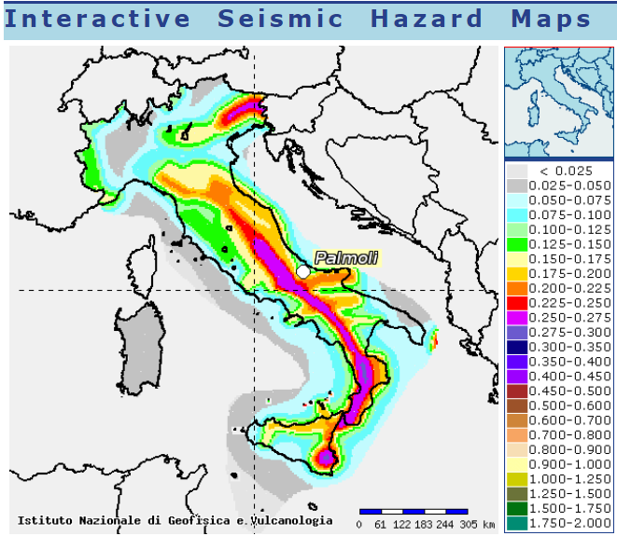
Trento, 02 December 2020
Ph.D. Student: Chiara Nardin
chiara.nardin@unitn.it
Introduction | Probabilistic Hazard Analysis | Fragility Analysis | References
Goal: to perform a PSHA analysis
Through the scheme depicted in (1), compute:
the annual hazard curve for each fault;
the 50 years hazard curve for each fault;
the 475 years hazard curve for each fault
for the highlighted seismic site.
http://esse1-gis.mi.ingv.it/
Seismic hazard map: shaking parameter PGA, site Palmoli (CH) Latitude 41,527 – Longitude 14,483.

Slide 23
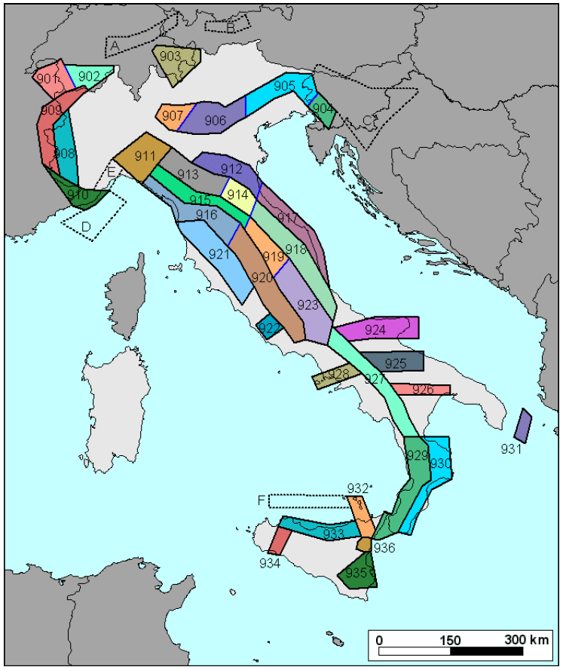
Trento, 02 December 2020
Ph.D. Student: Chiara Nardin
chiara.nardin@unitn.it
Introduction | Probabilistic Hazard Analysis | Fragility Analysis | References
Step 1: Source characterization
Localize seismogenetic zones: Italian ZS9* model for application of the attenuation law
Different characteristics of zonation by:
Seismogenetic faults and mechanisms (direct, inverse, strike-slip …)
Hypocenter depth (shallow, intermediate, deep)
ect.
Italian database and catalogue of the overall seismicity
http://zonesismiche.mi.ingv.it/

Slide 24
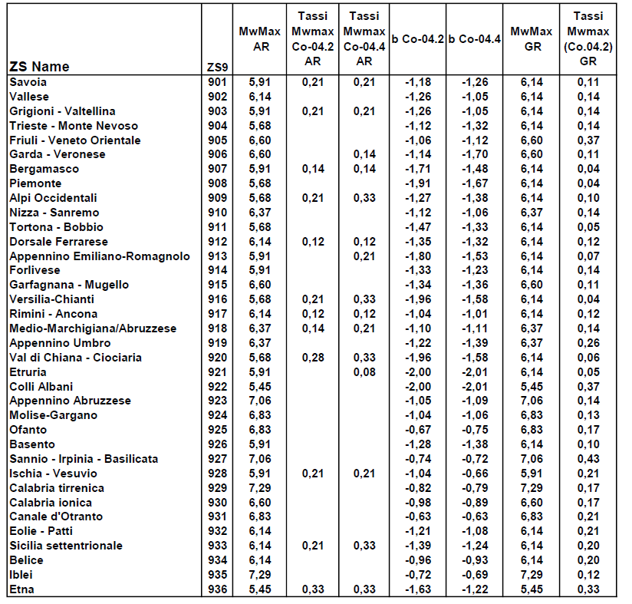
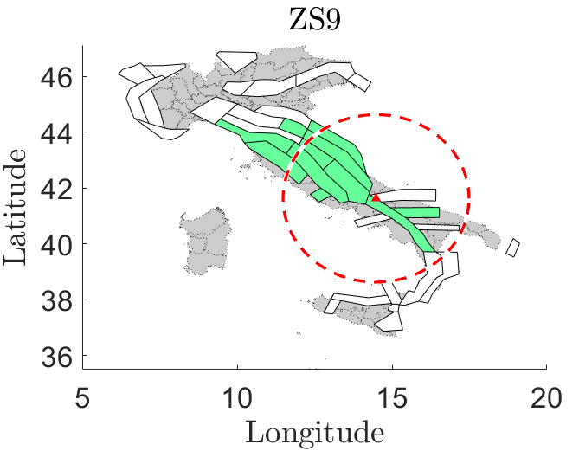
Trento, 02 December 2020
Ph.D. Student: Chiara Nardin
chiara.nardin@unitn.it
Introduction | Probabilistic Hazard Analysis | Fragility Analysis | References
Step 1: Source characterization
Localize seismogenetic zones: Italian ZS9* model for application of the attenuation law
http://zonesismiche.mi.ingv.it/

Slide 25
Trento, 02 December 2020
Ph.D. Student: Chiara Nardin
chiara.nardin@unitn.it
Introduction | Probabilistic Hazard Analysis | Fragility Analysis | References
Step 1: Source characterization
Extrapolate information regarding the source and its bound limits: convert coordinates from deg2utm for each sources
 | Coordinates
 | WGS 84 |  | UTM |  | UTM-Z
Location | long (x) | lat (y)
Palmoli | 14,48 | 41,63 | 465.293 | 4643124 | 33 T
ZS9-918 | S1
WGS 84 |  | UTM |  | UTM-Z | UTM-INPORT
12,11651 | 43,79397 | 268015,9 | 4853032 | 33 T | -197.277 | 209.907
12,27012 | 44,10645 | 281523,5 | 4887320 | 33 T | -183.769 | 244.196
13,54116 | 43,2943 | 381660,3 | 4794530 | 33 T | -83.633 | 151.405
14,181 | 42,47483 | 432678,9 | 4702824 | 33 T | -32.614 | 59.699
14,37249 | 42,14993 | 448153,3 | 4666614 | 33 T | -17.140 | 23.489
14,27923 | 41,85719 | 440174,4 | 4634171 | 33 T | -25.118 | -8.953
13,1518 | 43,02822 | 349423 | 4765606 | 33 T | -115.870 | 122.481
12,11651 | 43,79397 | 268015,9 | 4853032 | 33 T | -197.277 | 209.907
Source | b | Mw Max | Mw Min | Rate
S1 | -1,11 | 6,37 | 4,76 | 0,21
S2 | -1,09 | 7,06 | 4,76 | 0,14
… | … | … | … | …

Slide 26
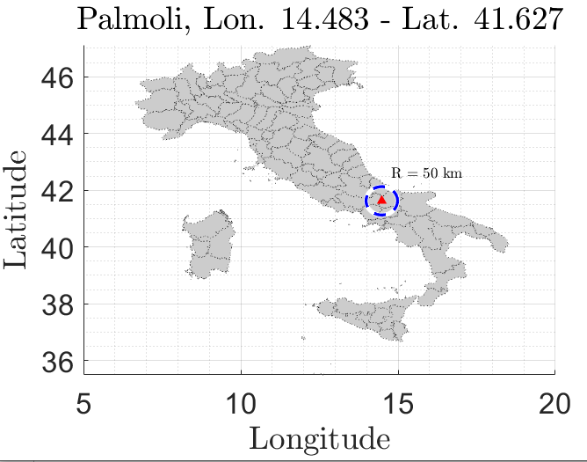
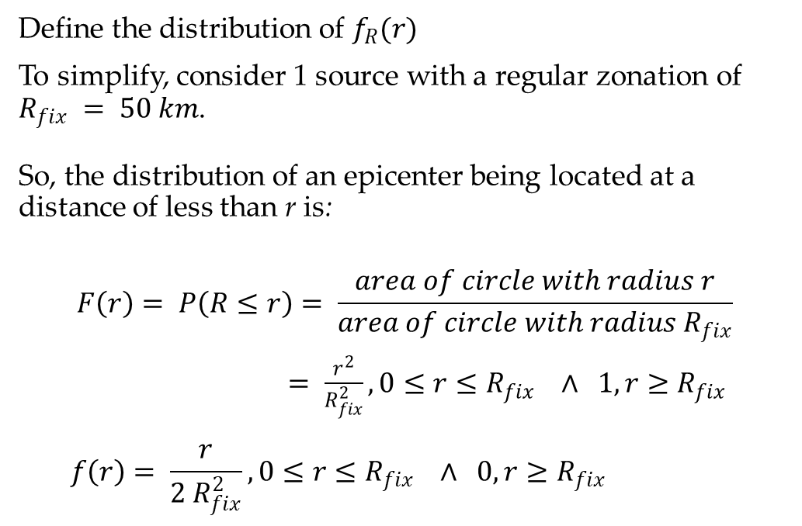
Trento, 02 December 2020
Ph.D. Student: Chiara Nardin
chiara.nardin@unitn.it
Introduction | Probabilistic Hazard Analysis | Fragility Analysis | References
Step 1: Source characterization - Location
Define the distribution of $f_{R}(r)$
To simplify, consider 1 source with a regular zonation of $R_{fix} = 50 km$.
So, the distribution of an epicenter being located at a distance of less than r is:
$$F\left(r\right)= P\left(R≤r\right)= \frac{area of circle with radius r}{area of circle with radius R_{fix}}$$
$= \frac{r^{2}}{R_{fix}^{2}}, 0≤r≤R_{fix} ∧ 1, r≥R_{fix}$
$$f\left(r\right)= \frac{r}{{2 R}_{fix}^{2}}, 0≤r≤R_{fix} ∧ 0, r≥R_{fix}$$
CDF:
PDF:

Slide 27
Trento, 02 December 2020
Ph.D. Student: Chiara Nardin
chiara.nardin@unitn.it
Introduction | Probabilistic Hazard Analysis | Fragility Analysis | References
Step 1: Source characterization
Codes:
Read source.xls file
Run section Earthquake source characterization in the attached Matlab code or load variable seismic_source.mat already prepared with the previously seen data

Slide 28
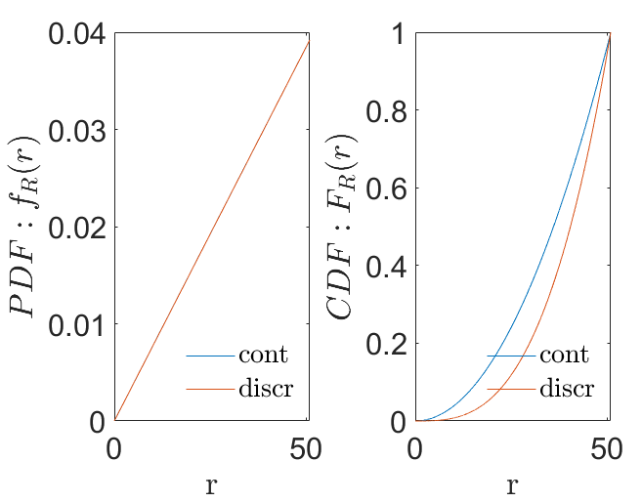
Trento, 02 December 2020
Ph.D. Student: Chiara Nardin
chiara.nardin@unitn.it
Introduction | Probabilistic Hazard Analysis | Fragility Analysis | References
Step 1: Source characterization - Location
Codes:
% PDF of R
rmax = Rmax*100; % 50km
rmin = Rmin.*100; % site
r_step = R_step;
r = rmin:r_step:(rmax-r_step);
Fr = r.^2./rmax.^2;
fr = 2*r./rmax.^2;
DFr = r_step;
frdiscr = zeros(1,numel(Fr));
Frdiscr = zeros(1,numel(Fr));
for idr = 2:numel(Fr)
frdiscr(idr) = -(Fr(idr-1)-Fr(idr))./(DFr);
Frdiscr(idr) = Frdiscr(idr-1)+Fr(idr);
end

Slide 29
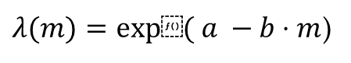
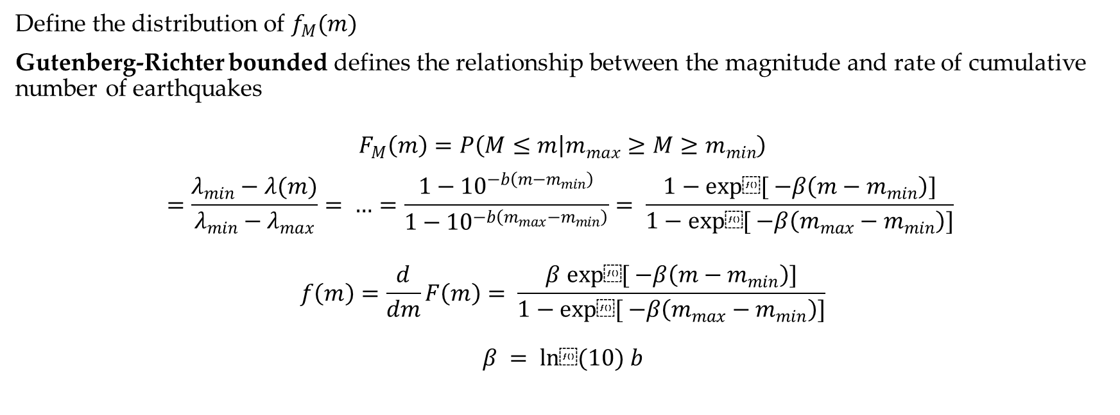
Trento, 02 December 2020
Ph.D. Student: Chiara Nardin
chiara.nardin@unitn.it
Introduction | Probabilistic Hazard Analysis | Fragility Analysis | References
Step 2: Earthquake size
$λ(m)=exp⁡( a −b⋅m$)
Define the distribution of $f_{M}(m)$
Gutenberg-Richter bounded defines the relationship between the magnitude and rate of cumulative number of earthquakes
$$F_{M}\left(m\right)=P\left(M≤m | m_{max}≥M≥m_{min}\right)$$
$$=\frac{λ_{min}−λ(m)}{λ_{min}−λ_{max}}= …=\frac{1−{10}^{−b\left(m−m_{min}\right)}}{1−{10}^{−b\left(m_{max}−m_{min}\right)}}= \frac{1−exp⁡[ −β\left(m−m_{min}\right)]}{1−exp⁡[ −β\left(m_{max}−m_{min}\right)]}$$
$$f\left(m\right)=\frac{d}{dm}F\left(m\right)= \frac{β exp⁡[ −β\left(m−m_{min}\right)]}{1−exp⁡[ −β\left(m_{max}−m_{min}\right)]}$$
$$β = ln⁡(10) b$$
CDF:
PDF:

Slide 30
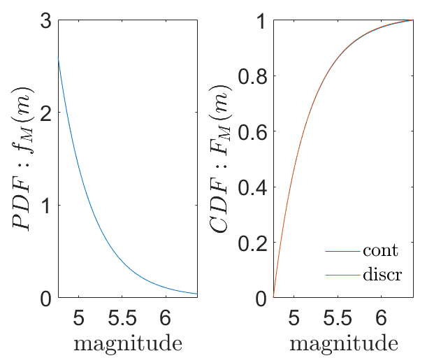

Trento, 02 December 2020
Ph.D. Student: Chiara Nardin
chiara.nardin@unitn.it
Introduction | Probabilistic Hazard Analysis | Fragility Analysis | References
Step 2: Earthquake size
Define the distribution of $f_{M}(m)$: Discretize
Converting the continuous distribution of magnitudes into a discrete set of magnitudes holds
$$P\left(M=m_{j}\right)=F_{M}\left(m_{j+1}\right)−F_{M}(m_{j})$$
where $m_{j}$ are the discrete set of magnitudes ordered so that $m_{j+1}<m_{j}$
Codes:
% PDF of M
Nm = 1000; % No. of discretized points between m0 and mu for numerical integration
M = linspace(m0,mu,Nm); %mo = m_min
fM = beta*exp(-beta*(M-m0))/(1-exp(-beta*(mu-m0)));
dM=M(2)-M(1);
Mdiscr=fM*dM;

Slide 31
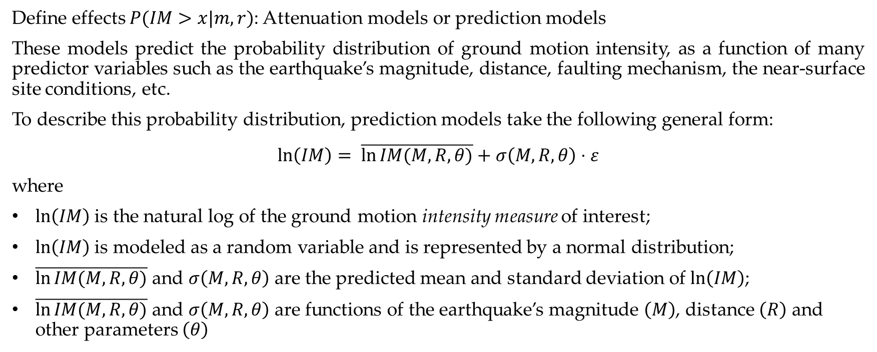
Trento, 02 December 2020
Ph.D. Student: Chiara Nardin
chiara.nardin@unitn.it
Introduction | Probabilistic Hazard Analysis | Fragility Analysis | References
Step 3: Ground motion estimation
Define effects $P(IM>x|m,r)$: Attenuation models or prediction models
These models predict the probability distribution of ground motion intensity, as a function of many predictor variables such as the earthquake’s magnitude, distance, faulting mechanism, the near-surface site conditions, etc.
To describe this probability distribution, prediction models take the following general form:
$$\ln\left(IM\right)= \overline{\ln{IM(M,R,θ)}}+σ\left(M,R,θ\right)⋅ε$$
where
$ln\left(IM\right)$ is the natural log of the ground motion intensity measure of interest;
$ln\left(IM\right)$ is modeled as a random variable and is represented by a normal distribution;
$\overline{\ln{IM(M,R,θ)}}$ and $σ\left(M,R,θ\right)$ are the predicted mean and standard deviation of $ln\left(IM\right)$;
$\overline{\ln{IM(M,R,θ)}}$ and $σ\left(M,R,θ\right)$ are functions of the earthquake’s magnitude $\left(M\right)$, distance $\left(R\right)$ and other parameters $\left(θ\right)$

Slide 32

Trento, 02 December 2020
Ph.D. Student: Chiara Nardin
chiara.nardin@unitn.it
Introduction | Probabilistic Hazard Analysis | Fragility Analysis | References
Step 3: Ground motion estimation
Define effects $P(IM>x|m,r)$: Attenuation models or prediction models
Here, for clarity, it is assumed Cornell (1979) for the mean of log peak ground acceleration (in units of g):
$$\overline{\ln{PGA}}=−0,152+0,859M −1,803 ln⁡(R+25)$$
with
$σ=0,57$ of $ln⁡(PGA)$;
$ln⁡(PGA)$ normally distributed

Slide 33

Trento, 02 December 2020
Ph.D. Student: Chiara Nardin
chiara.nardin@unitn.it
Introduction | Probabilistic Hazard Analysis | Fragility Analysis | References
Step 3: Ground motion estimation
Define effects $P(IM>x|m,r)$: Attenuation models or prediction models
We can thereby compute the probability of exceeding any PGA level using knowledge of this mean and standard deviation:
$$P\left(PGA>x | m,r\right)=1−Φ\left(\frac{\ln{x −\ln{\overline{PGA}}}}{σ_{\ln\left(PGA\right)}}\right)$$
where $Φ\left( \right)$is the standard normal cumulative distribution function.
N.B.: these probabilities correspond to the fraction
of the corresponding PDFs that are shaded.

Slide 34

Trento, 02 December 2020
Ph.D. Student: Chiara Nardin
chiara.nardin@unitn.it
Introduction | Probabilistic Hazard Analysis | Fragility Analysis | References
Step 3: Ground motion estimation
Define effects $P(IM>x|m,r)$: Attenuation models or prediction models
Codes:
function [mean_im, sigma_im] = GMPE(magnitude,R_distance)
%Cornell et al. (1979): Ground motion predictive equation for PGA
mean_lnPGA = -0.152+0.859*magnitude -1.803*log(R_distance+25);
mean_PGA = exp(mean_lnPGA);
mean_im = mean_PGA;
sigma_im = 0.57;
end

Slide 35
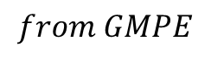
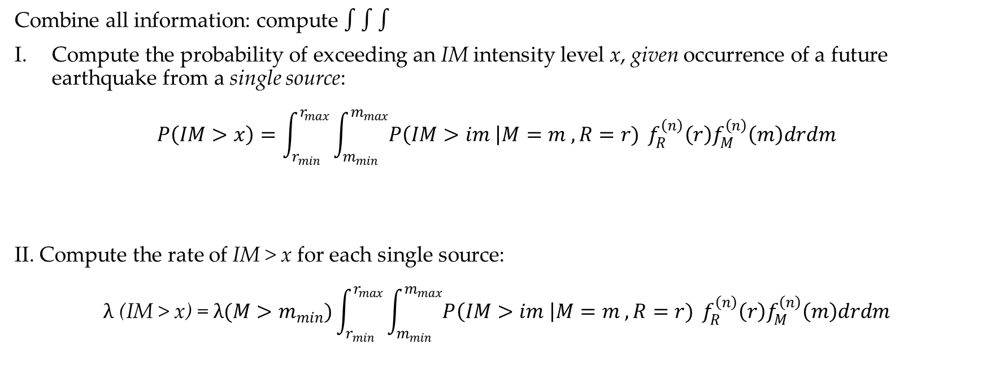
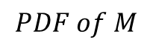

Trento, 02 December 2020
Ph.D. Student: Chiara Nardin
chiara.nardin@unitn.it
Introduction | Probabilistic Hazard Analysis | Fragility Analysis | References
Step 4: Hazard Computation
Combine all information: compute $∫∫∫$
Compute the probability of exceeding an IM intensity level x, given occurrence of a future earthquake from a single source:
$$P\left(IM>x\right)=\int_{r_{min}}^{r_{max}}{\int_{m_{min}}^{m_{max}}{P\left(IM>im \right|M=m , R=r)}} f_{R}^{\left(n\right)}\left(r\right)f_{M}^{\left(n\right)}\left(m\right)drdm$$
II. Compute the rate of IM > x for each single source:
$$λ \text{(}\text{IM} \text{> }\text{x}\text{)} \text{=} λ(M>m_{min})\int_{r_{min}}^{r_{max}}{\int_{m_{min}}^{m_{max}}{P\left(IM>im \right|M=m , R=r)}} f_{R}^{\left(n\right)}\left(r\right)f_{M}^{\left(n\right)}\left(m\right)drdm$$
$$from GMPE$$
$$PDF of R$$
$$PDF of M$$

Slide 36

Trento, 02 December 2020
Ph.D. Student: Chiara Nardin
chiara.nardin@unitn.it
Introduction | Probabilistic Hazard Analysis | Fragility Analysis | References
Step 4: Hazard Computation
Combine all information: compute $∫∫∫$
III. Considering all sources by the sum of the rates of IM > x from each individual source, we can write:
$$λ\left(IM>x\right)=\sum_{i=1}^{n_{sources}}{λ(M_{i}>m_{min})\int_{r_{min}}^{r_{max}}{\int_{m_{min}}^{m_{max}}{P\left(IM>im \right|M=m , R=r)}} f_{R_{i}}^{\left(n\right)}\left(r\right)f_{M_{i}}^{\left(n\right)}\left(m\right)drdm }$$
where $n_{sources}$ is the number of sources considered, and $M_{i} \sim R_{i}$ denote the magnitude ~ distance
distributions for source i
Notes:
$$λ(M>m_{min})\int_{r_{min}}^{r_{max}}{\int_{m_{min}}^{m_{max}}{P\left(IM>im \right|M=m , R=r)}} f_{R}^{\left(n\right)}\left(r\right)f_{M}^{\left(n\right)}\left(m\right)drdm$$

Slide 37

Trento, 02 December 2020
Ph.D. Student: Chiara Nardin
chiara.nardin@unitn.it
Introduction | Probabilistic Hazard Analysis | Fragility Analysis | References
Step 4: Hazard Computation
Combine all information: compute $∫∫∫$ - Discretize
IV. By discretizing:
$${λ\left(im\right)≈\sum_{n=1}^{N_{s}}{\sum_{m=1}^{N_{r}}{\sum_{l=1}^{N_{m}}{λ_{min}^{\left(n\right)}}P\left(IM>im | M^{\left(n\right)}=m_{l}, R^{\left(n\right)}=r_{m}\right)P\left(R^{\left(n\right)}=r_{m} | m_{l}\right)P(M^{(n)}=m_{l})} }}_{}$$
where the range of possible $M_{i}$ and $R_{i}$ have been discretized into $n_{M}$ and $n_{R}$ intervals, respectively
Notes:
$$λ(M>m_{min})\int_{r_{min}}^{r_{max}}{\int_{m_{min}}^{m_{max}}{P\left(IM>im \right|M=m , R=r)}} f_{R}^{\left(n\right)}\left(r\right)f_{M}^{\left(n\right)}\left(m\right)drdm$$

Slide 38

Trento, 02 December 2020
Ph.D. Student: Chiara Nardin
chiara.nardin@unitn.it
Introduction | Probabilistic Hazard Analysis | Fragility Analysis | References
Step 4: Hazard Computation
Goal and results
Through the scheme depicted in (1), compute:
the annual hazard curve for each fault;
the 50 years hazard curve for each fault;
the 475 years hazard curve for each fault
for the highlighted seismic site.
Notes:
$$λ(M>m_{min})\int_{r_{min}}^{r_{max}}{\int_{m_{min}}^{m_{max}}{P\left(IM>im \right|M=m , R=r)}} f_{R}^{\left(n\right)}\left(r\right)f_{M}^{\left(n\right)}\left(m\right)drdm$$

Slide 39


Trento, 02 December 2020
Ph.D. Student: Chiara Nardin
chiara.nardin@unitn.it
Introduction | Probabilistic Hazard Analysis | Fragility Analysis | References
Step 4: Hazard Computation
Notes:
$$λ(M>m_{min})\int_{r_{min}}^{r_{max}}{\int_{m_{min}}^{m_{max}}{P\left(IM>im \right|M=m , R=r)}} f_{R}^{\left(n\right)}\left(r\right)f_{M}^{\left(n\right)}\left(m\right)drdm$$

Slide 40
Trento, 02 December 2020
Ph.D. Student: Chiara Nardin
chiara.nardin@unitn.it
Introduction | Probabilistic Hazard Analysis | Fragility Analysis | References
Summary
Location
$P=1−e^{−λt}$ Poisson model
𝑃=1−𝑒^(−𝜆𝑡) Poisson model
Size
Time
$f_{R}\left(r\right)$ source site distance
𝑓_𝑅 (𝑟) source site distance
GMPE
$f_{M}\left(m\right)$ magnitude distribution
𝑓_𝑀 (𝑚) magnitude distribution
$P\left(IM>im \right|M=m , R=r)$ attenuation law
𝑃(𝐼𝑀>𝑖𝑚 ┤|𝑀=𝑚 , 𝑅=𝑟) attenuation law
Notes:
$$λ(M>m_{min})\int_{r_{min}}^{r_{max}}{\int_{m_{min}}^{m_{max}}{P\left(IM>im \right|M=m , R=r)}} f_{R}^{\left(n\right)}\left(r\right)f_{M}^{\left(n\right)}\left(m\right)drdm$$

Slide 41
Trento, 02 December 2020
Ph.D. Student: Chiara Nardin
chiara.nardin@unitn.it
Fragility Analysis
Formulation and MatLab Computation
Ph.D. Student Chiara Nardin – M.Sc., Eng. in Civil Engineering

Slide 42
Trento, 02 December 2020
Ph.D. Student: Chiara Nardin
chiara.nardin@unitn.it
Introduction | Probabilistic Hazard Analysis | Fragility Analysis | References
Fragility Analysis
Hazard analysis
intensity measure
Loss analysis
decision variable
HAZARD
VULNERABILITY
Damage analysis
damage measure
DECISION MAKING
VULNERABILITY
Vulnerability analysis
engineering demand par.
Fragility (or Vulnerability) Analysis is the second step of the PBEE-PEER framework
Useful definitions:
seismic fragility function := the conditional probability of an event given the observation of an intensity measure which describe the seismic event.
$$p\left(IM\right|M,R)$$
$$↓$$
$$p(IM)$$
$$p\left(EDP\right|IM)$$
$$↓$$
$$p(EDP)$$
$$p\left(DM\right|EDP)$$
$$↓$$
$$p(DM)$$
$$p\left(DV\right|DM)$$
$$↓$$
$$p(DV)$$
Notes:
SHA is the basis for many earthquake design codes practices and for seismic risk analysis of civil systems.

Slide 43




Trento, 02 December 2020
Ph.D. Student: Chiara Nardin
chiara.nardin@unitn.it
Introduction | Probabilistic Hazard Analysis | Fragility Analysis | References
Fragility Analysis
Vulnerability analysis
engineering demand par.
The fragility curve is defined as the conditional probability of failure of a structure, or its critical components, at given values of seismic intensity measures (IMs).
In practice, a fragility curve is calculated as the conditional probability that the damage measure (D) exceeds a critical threshold, for a given seismic IM.
$$P \left(D>d_{threshold} \right| IM=im)$$
VULNERABILITY
$$p\left(EDP\right|IM)$$
$$↓$$
$$p(EDP)$$
Damage analysis
damage measure
VULNERABILITY
$$p\left(DM\right|EDP)$$
$$↓$$
$$p(DM)$$
Notes:
SHA is the basis for many earthquake design codes practices and for seismic risk analysis of civil systems.

Slide 44

Trento, 02 December 2020
Ph.D. Student: Chiara Nardin
chiara.nardin@unitn.it
Introduction | Probabilistic Hazard Analysis | Fragility Analysis | References
Fragility Analysis: key aspects
Vulnerability analysis
engineering demand par.
INTENSITY MEASURE $(IM)$ | DAMAGE STATE $(D)$
in terms of: Efficiency, i.e. variability of an EDP for a given IM; Robustness, i.e. efficiency between IM-EDP at different period ranges; Practicality, i.e. correlation to known and easy identifiable engineering quantities; Sufficiency, i.e. validity of EDP|IM as statistically independent from gm site characteristics; Effectiveness, i.e. ability to evaluate an analytical relation. | Should suit the specific structural problem → associate each damage state to a specific EDP Categorical variables, i.e. $D_{0}$ no damages – $D_{1}$ minor – $D_{2} moderate − …−D_{f}=C collapse$; Probabilistic or deterministic relationship between EDP and D
VULNERABILITY
$$p\left(EDP\right|IM)$$
$$↓$$
$$p(EDP)$$
Damage analysis
damage measure
VULNERABILITY
$$p\left(DM\right|EDP)$$
$$↓$$
$$p(DM)$$
Notes:
SHA is the basis for many earthquake design codes practices and for seismic risk analysis of civil systems.

Slide 45
Trento, 02 December 2020
Ph.D. Student: Chiara Nardin
chiara.nardin@unitn.it
Introduction | Probabilistic Hazard Analysis | Fragility Analysis | References
Class of fragilities
EMPIRICAL | ANALYTICAL | EXPERT OPINION | HYBRID
by fitting a function to observational data from past earthquakes or lab tests collections pairs of level of excitation and categorical variables of damage or collapse | by defining analytical structural model and analyzing its performance under different levels of the seismic hazard static, i.e. hazard as response spectrum and push-over analysis vs dynamic, i.e. collection of gms and simulations on FEM via NLA | by polling one or more experts of the given structural asset to guess or estimate the failure probability for a given hazard level | based on combination of the different methods
Notes:
SHA is the basis for many earthquake design codes practices and for seismic risk analysis of civil systems.

Slide 46


Trento, 02 December 2020
Ph.D. Student: Chiara Nardin
chiara.nardin@unitn.it
Introduction | Probabilistic Hazard Analysis | Fragility Analysis | References
Dynamic based fragility functions: steps
Definition of a numerical model:
Selection of a suitable $IM$given the structure
Selection of a suitable set of $N$ gms for the location
Selection of an $EDP$ of interest
Definition of damage limit states $D$ via $EDP$thresholds
Scale each gm based on the given $IM$eventually until collapse
Save each $\left[EDP→D\right]$ threshold-$im_{n}$ pair for each gm
Full IDA
Truncated IDA
Notes:
SHA is the basis for many earthquake design codes practices and for seismic risk analysis of civil systems.

Slide 47








Trento, 02 December 2020
Ph.D. Student: Chiara Nardin
chiara.nardin@unitn.it
Introduction | Probabilistic Hazard Analysis | Fragility Analysis | References
Computation of fragility function
Hp: - assume a lognormal probabillity distribution for the random variable $IM$ associated with given $D$
FULL IDA | TRUNCATED IDA
$∀$ damage state $→N$ results, since $∀ IM_{n}=im_{n}, y(t)$reached the given damage state where $Φ(⋅)$ is the CDF of the normal distribution and | $\overline{IM}$upper limit; data that causes collapse $n∈[1,\overline{N}]$, data that do not cause collapse $n∈[\overline{N}+1,N]$ a) $→$ b) $→$ a)+b) $→$
Notes:
SHA is the basis for many earthquake design codes practices and for seismic risk analysis of civil systems.

Slide 48



Trento, 02 December 2020
Ph.D. Student: Chiara Nardin
chiara.nardin@unitn.it
Introduction | Probabilistic Hazard Analysis | Fragility Analysis | References
Computation of fragility function
TRUNCATED IDA
$$\left(1\right)$$ $$\left(2\right)$$
The likelihood for the entire set of data
And the log likelihood
Estimation of parameters by optimization
Notes:
SHA is the basis for many earthquake design codes practices and for seismic risk analysis of civil systems.

Slide 49





Trento, 02 December 2020
Ph.D. Student: Chiara Nardin
chiara.nardin@unitn.it
Introduction | Probabilistic Hazard Analysis | Fragility Analysis | References
Computation of fragility function
For a generic $f(x;θ)$
And the log likelihood
Estimation of parameters by optimization
Fig.1 – Fragility function computed via IDA, see Broccardo, M. (2018) Probabilistic seismic risk analysis for civil systems, Lecture Notes.
Notes:
SHA is the basis for many earthquake design codes practices and for seismic risk analysis of civil systems.

Slide 50
Trento, 02 December 2020
Ph.D. Student: Chiara Nardin
chiara.nardin@unitn.it
Fragility Analysis
Formulation and MatLab Computation
Ph.D. Student Chiara Nardin – M.Sc., Eng. in Civil Engineering

Slide 51

Trento, 02 December 2020
Ph.D. Student: Chiara Nardin
chiara.nardin@unitn.it
Introduction | Probabilistic Hazard Analysis | Fragility Analysis | References
Goal: to perform fragility analysis
Given the provided set of ground motions, perform a classical and truncated incremental dynamic analysis (IDA) and determine fragility curves for:
ATTEL – moment resistant frame (MRF);
ATTEL – braced frame (BF)
by considering both
Linear elastic behaviour
Bouc – Wen model for hysteresis
3D model of the case study ATTEL – SERA project.

Slide 52

Trento, 02 December 2020
Ph.D. Student: Chiara Nardin
chiara.nardin@unitn.it
Introduction | Probabilistic Hazard Analysis | Fragility Analysis | References
Main steps:
Definition of the numerical model
Input and IM selection
Definition of damage limit states and reference EDP
Performing non-linear time histories analysis (IDA, truncated IDA, cloud, MSA …)
Collecting results pairs and computing fragility
3D model of the case study ATTEL – SERA project.

Slide 53


Trento, 02 December 2020
Ph.D. Student: Chiara Nardin
chiara.nardin@unitn.it
Introduction | Probabilistic Hazard Analysis | Fragility Analysis | References
Step 1: the case study ATTEL⁽¹⁾
^{[1]}BURSI, PUCINOTTI, TONDINI, ZANON, Tests and model calibration of high strength steel tubular beam-to-column and column-base composite joints for moment-resisting structures, Earthquake Engineering and Structural Dynamics, (2015).
T₁ = 2,79 s
T₁ = 0,46 s
3D model of the case study ATTEL – SERA project.
Main sections of the moment resistent frame and the braced one.

Slide 54







Trento, 02 December 2020
Ph.D. Student: Chiara Nardin
chiara.nardin@unitn.it
Introduction | Probabilistic Hazard Analysis | Fragility Analysis | References
Designed according to EC8 and modelled in OS:
beam and column elements with linear elastic behavior
mechanical nonlinearities
geometric nonlinearities
Model of the structure in OpenSees.
Notes:
Le strutture, progettate secondo criteri e norme antisismiche, sono state modellate dettagliatamente prima in OpenSees, software opensource sviluppato a Berkeley per l’analisi strutturale e geotecnica agli elementi finiti. Il modello, sviluppato in un precedente lavoro di tesi magistrale degli ingegneri Fassin ed Eccher, è stato realizzato mediante l’utilizzo di elementi elastici lineari BeamColumn, concentrando invece le non linearità meccaniche nelle c.p., considerando un modello isteretico di BW e fenomenologico di pinching calibrato sperimentalmente sui dettagli costruttivi dei giunti, oggetto di altri lavori di tesi. Sono state inoltre considerate le non linearità geometriche mediante gli effetti P-Delta.

Slide 55

Trento, 02 December 2020
Ph.D. Student: Chiara Nardin
chiara.nardin@unitn.it
Introduction | Probabilistic Hazard Analysis | Fragility Analysis | References
to reduce computational burden
to reduce required simulation times
High number of analysis
for seismic simulations
Calibration oriented to correspondence of:
main periods
modes of vibrating
dissipative behavior
high fidelity model in OpenSees - OS
simplified model MDOF in MATLAB ® - ML
Notes:
Viste però le numerose analisi e simulazioni richieste per la stesura del modello probabilistico, è stato necessario passare da una struttura complessa ad una MDOF più semplice per motivi di onere computazionale e tempi di analisi impiegati. Si è svolta pertanto una procedura di calibrazione volta alla corrispondenza di periodi principali, modi di vibrare e comportamento dissipativo.

Slide 56






Trento, 02 December 2020
Ph.D. Student: Chiara Nardin
chiara.nardin@unitn.it
Introduction | Probabilistic Hazard Analysis | Fragility Analysis | References
Hysteretic model of Bouc Wen
Hysteretic model of Bouc Wen.
Formulation of the problem and examples of hysteretic cycles.
Notes:
In particolare nella condensazione della struttura al modello in ML si è prestata specifica attenzione al comportamento isteretico, sviluppando un apposito modello di Bouc-Wen per tenere in conto della risposta in campo non lineare associata al degrado in termini di resistenza e rigidezza della struttura.
Peculiarità del modello isteretico risiede nel definire la Fs forza di richiamo come il contributo di due termini in parallelo: il primo rappresentante un contributo elastico, il secondo il contributo dissipativo.

Slide 57



Trento, 02 December 2020
Ph.D. Student: Chiara Nardin
chiara.nardin@unitn.it
Introduction | Probabilistic Hazard Analysis | Fragility Analysis | References
Data exploration of recorded gms
Scatter plot and statistic tools to evaluate proper IM
Step 2: input and IM selection
Acceleration, velocity and displacement response spectra with mean value, 10^{-th} and 90^{-th} quantile.
Scatter plot for correlation.

Slide 58
Trento, 02 December 2020
Ph.D. Student: Chiara Nardin
chiara.nardin@unitn.it
Introduction | Probabilistic Hazard Analysis | Fragility Analysis | References
Step 2: input and IM selection
Codes:
%% Ground motions
Ground_motions = load('accelrot_cellarray.mat');
%
NN = [1, 2, 3, 4, 5, 6, 7, 8, 9, 10, 11, 12, 13, 14, 16, 17, 19, 21, 23, 24,...
25, 26, 28, 29, 30, 31, 32, 33, 34, 36, 37]; % number ID of the SS ground motions
DT = [0.01 , 0.01 , 0.005, 0.005, 0.005, 0.005, 0.02 , 0.02, 0.02, 0.01,...
0.01 , 0.01 , 0.02 , 0.02 , 0.02 , 0.02 , 0.02 , 0.02, 0.01, 0.01,...
0.005, 0.005, 0.005, 0.005, 0.02 , 0.005, 0.005, 0.01, 0.01, 0.01,...
0.01 , 0.005, 0.005, 0.02 , 0.005, 0.01 , 0.01]; % integration time step

Slide 59



Trento, 02 December 2020
Ph.D. Student: Chiara Nardin
chiara.nardin@unitn.it
Introduction | Probabilistic Hazard Analysis | Fragility Analysis | References
Step 3: Definition of damage limit states and reference EDP
MRF
BF
Document FEMA 356 - Prestandard and Commentary for the Seismic Rehabilitation of Buildings; Table C1-3 - Structural Performance Levels and Damage.

Slide 60
Trento, 02 December 2020
Ph.D. Student: Chiara Nardin
chiara.nardin@unitn.it
Introduction | Probabilistic Hazard Analysis | Fragility Analysis | References
Step 3: Definition of damage limit states and reference EDP
Codes:
%% MDOF Properties
% Choose between the structural system
MDOF_properties_BW_MRF
MDOF_properties_BW_BF
% and between linear or hysteretic behaviour
%% Structural behaviour
System_type = ‘le’; % ‘bw’
% bw = bouc-wen
% le = linear elastic
…
%% Limit States
LS = [0.50 0.75 1 2 3]*4/100;
for ls_i = 1:numel(LS)
ls_val = LS(ls_i)
Main_IDA_o_t
ls_i = ls_i + 1;
end

Slide 61
Trento, 02 December 2020
Ph.D. Student: Chiara Nardin
chiara.nardin@unitn.it
Introduction | Probabilistic Hazard Analysis | Fragility Analysis | References
Step 4: Performing non-linear time histories analysis
Codes:
%% Initial condition
Mat.dFe=zeros(Mat.NDOF,numel(a_g_norm)); % Preallocation for the load for the time series
a_g = a_g_norm*scale; % Scaled ground motion
Mat.Fe=Mat.M*Mat.r'*a_g'*g;
%% Computation response
[HistVarBw]=ResponceMDF_Bw(Mat);
edp = max(abs(HistVarBw.eps(1,:)));
EDP(i) = edp; %store the EDP for each time history analysis
SCALE(i) = scale; %store the scale factor for each time history analysis…

Slide 62



Trento, 02 December 2020
Ph.D. Student: Chiara Nardin
chiara.nardin@unitn.it
Introduction | Probabilistic Hazard Analysis | Fragility Analysis | References
Step 5: Computing fragilities
Codes:
%% Untruncated IDA
[parmhat,parmci] = lognfit(IM_t_c ,0.01);
mu_IDA = parmhat(1);
sigma_IDA = parmhat(2);
%% Truncated IDA
IM_max = 2.2;
IM_trunc = IM_t_c(IM_t_c < IM_max); % take only the results with IM < IM_max
eq_over = sum(IM_t_c >= IM_max); % number of analyses reached IM_max without collapsing
% Maximum likelihood fit, using equation (1) and (2) of previously slides
[mu_IDA_t, sigma_IDA_t ] = truncated_ida(IM_trunc, IM_max, eq_over);

Slide 63

Trento, 02 December 2020
Ph.D. Student: Chiara Nardin
chiara.nardin@unitn.it
Introduction | Probabilistic Hazard Analysis | Fragility Analysis | References
Step 5: Computing fragilities - Results

Slide 64
Trento, 02 December 2020
Ph.D. Student: Chiara Nardin
chiara.nardin@unitn.it
References
Ph.D. Student Chiara Nardin – M.Sc., Eng. in Civil Engineering

Slide 65
Trento, 02 December 2020
Ph.D. Student: Chiara Nardin
chiara.nardin@unitn.it
Introduction | Probabilistic Hazard Analysis | Fragility Analysis | References
References:
Baker J. W. (2008). An Introduction to Probabilistic Seismic Hazard Analysis (PSHA), White Paper, Version 1.3, 72 pp.
Kramer, S.L. (1996) Geotechnical earthquake engineering. Prentice Hall, Upper Saddle River, N.J.
Wells, D.L. and Coppersmith, K.J. (1994) New empirical relationships among magnitude, rupture length, rupture width, rupture area, and surface displacement. Bull. Seism. Soc. Am., 84, 974-1002.
Cornell, C.A. (1968). Engineering seismic risk analysis, Bull. Seism. Soc. Am., 58, 1583-1606.
Broccardo, M. (2018) Probabilistic seismic risk analysis for civil systems, Lecture Notes
Stucchi M., Meletti C., Montaldo V., Akinci A., Faccioli E., Gasperini P., Malagnini L., Valensise G. (2004). Pericolosità sismica di riferimento per il territorio nazionale MPS04. Istituto Nazionale di Geofisica e Vulcanologia (INGV). https://doi.org/10.13127/sh/mps04/agKramer, S.L. (1996) Geotechnical earthquake engineering. Prentice Hall, Upper Saddle River, N.J.
http://zonesismiche.mi.ingv.it/ → Italian database

